Slide 1

#LifeKoKaroLift
Lending Club Case Study By:
Kavi Prakash Manoharan
Naresh Kuppili

Slide 2
Agenda
Problem Statement
Discussion over solution approach
Q & A

Slide 3
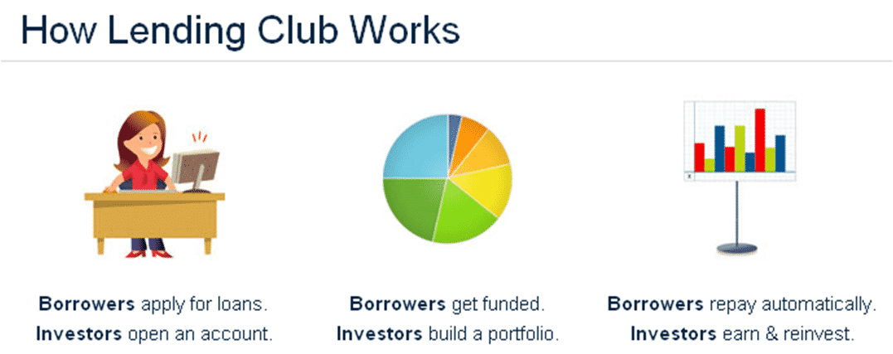
Lending Club: Problem Statement
What is Lending Club?
Lending Club is a marketplace for personal loans that matches borrowers who are seeking a loan with investors looking to lend money and make a return.
When the company receives a loan application, the company has to make a decision for loan approval based on the applicant’s profile. Two types of risks are associated with the bank’s decision:
If the applicant is likely to repay the loan, then not approving the loan results in a loss of business to the company
If the applicant is not likely to repay the loan, i.e. he/she is likely to default, then approving the loan may lead to a financial loss for the company
05-07-2022

Slide 4

Lending Club: Solution
We have applied several EDA data analysis techniques to reduce the risk of finance or business loss for the Lending Club clients.
In other words, the company wants to understand the driving factors (or driver variables) behind loan default, i.e. the variables which are strong indicators of default. The company can utilize this knowledge for its portfolio and risk assessment.
05-03-2022

Slide 5
Lending Club: Default Indicators
Loan purpose: Debt Consolidation or Small Business
Loan Term: Long Term
Loan Amount: Greater Then $15,000
Applicant State: CA, NY, Florida, New Jersey
Employment Length: 1 to 3 years or 10+ years
Annual Income is less than $60,000
Monthly Installment Amount greater than $410
Interest Rate greater than 15%
Applicant stays in Rental or Mortgage home
05-07-2022

Slide 6
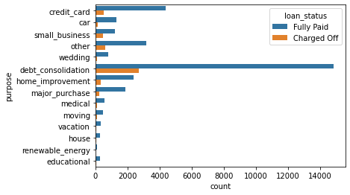
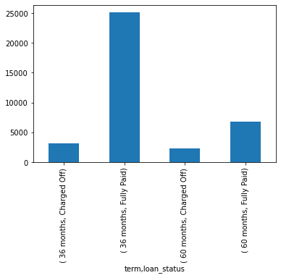
Lending Club: Supporting Case Study
Loan Purpose Loan Term
05-07-2022

Slide 7
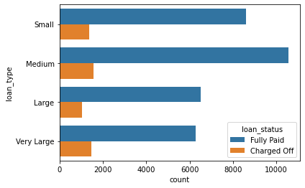
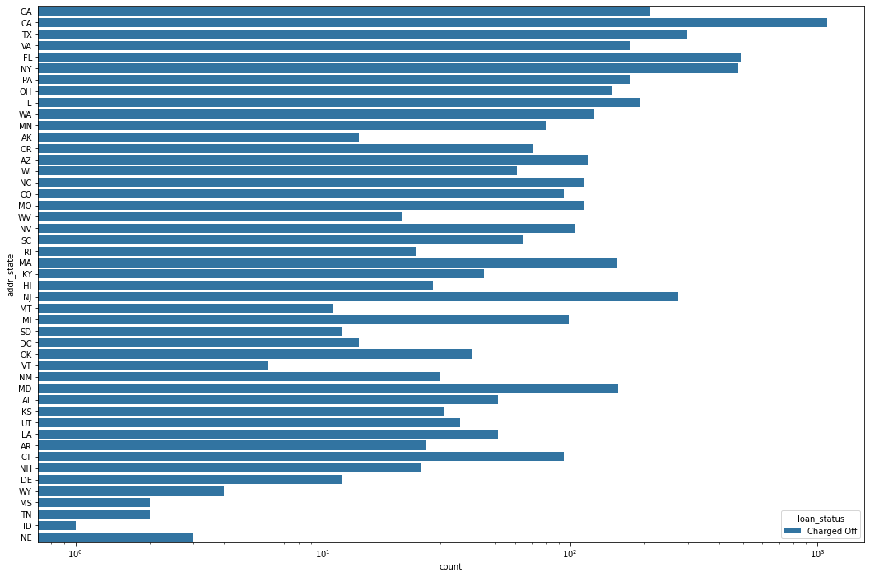
Lending Club: Supporting Case Study
Loan Amount Applicant State
<=5500 - Small
> 5500 <= 10000 - Medium
> 10000 <= 15000 - Large
> 15000 - Very Large
05-07-2022

Slide 8
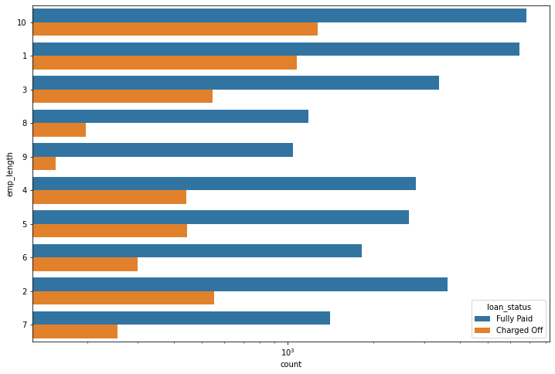
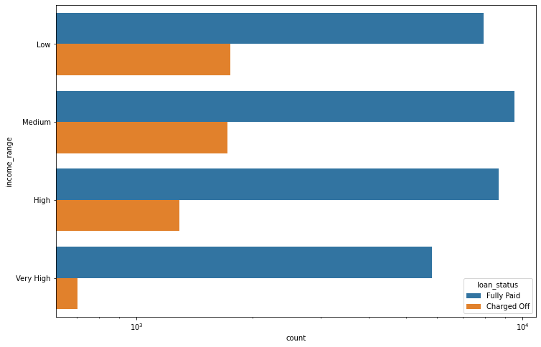
Lending Club: Supporting Case Study
Employment Length Annual Income
<= 40000 - Low
> 40000 and < 60000 - Medium
> 60000 and <90000 - High
> 90000 -- Very High
05-07-2022

Slide 9
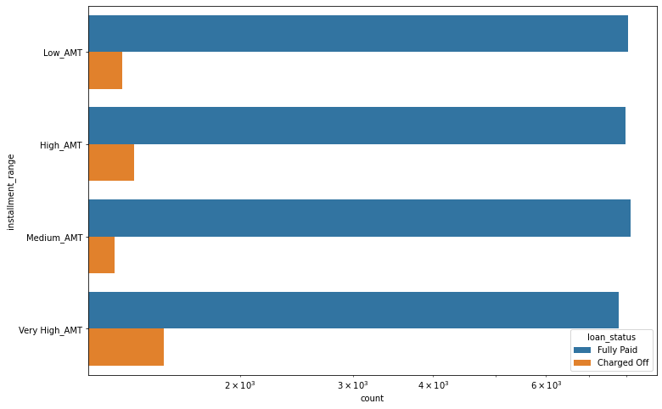
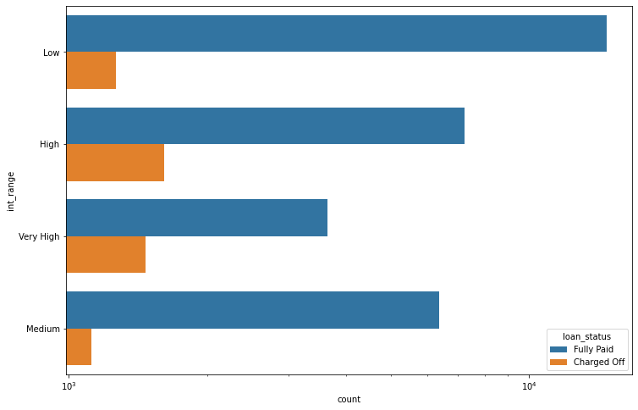
Lending Club: Supporting Case Study
Monthly Installment Interest Rate
<= 163 - Low_AMT
> 163 and <= 272 -- Medium_AMT
> 272 and <=410 - High_AMT
> 410 - Very_High_AMT
<= 10% - Low
> 10 and <=12 - Medium
> 12 and <= 15 - High
> 15 - Very High
05-07-2022

Slide 10
#LifeKoKaroLift
Thank You!
https://github.com/kaviprakashm/LendingClub_Data_Analysis.git

